Slide 1
Cryptographic Fundamentals for IoT Security Engineering
Academy of Cryptography Techniques
CHAT
Dr. Pham Van Huong
0902 122 010
HuongPV@gmail.com

Slide 2
Contents
Cryptography and its role in securing the IoT
1
2
Cryptographic module principles
3
Cryptographic key management fundamentals
Examining cryptographic controls for IoT protocols
4
4
5
5
4
Future directions of the IoT and cryptography
5

Slide 3
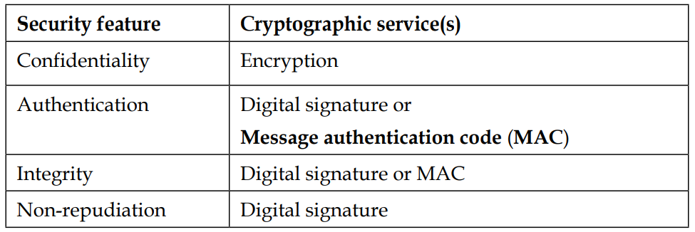
Cryptography and its role in securing the IoT

Slide 4
Types and uses of cryptographic primitives in the IoT
Cryptographic primitive types fall into the following categories:
Encryption (and decryption):
Symmetric
Asymmetric
Hashing
Digital signatures
Symmetric: MAC used for integrity and data-origin authentication
Asymmetric: RSA, Elliptic curve (EC) and integer factorization cryptography (IFC). These provide integrity, identity, and data origin authentication as well as non-repudiation
Random number generation: The basis of most cryptography requires very large numbers originating from high entropy sources

Slide 5
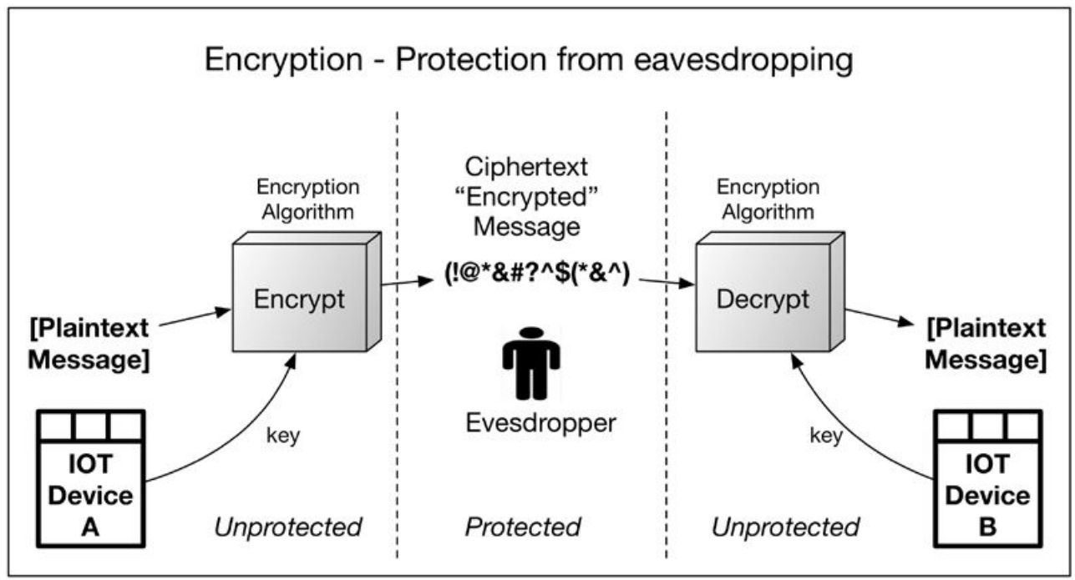
Encryption and decryption
Encryption is the cryptographic service most people are familiar with as it is used to so-called scramble or mask information so that unintended parties cannot read or interpret it

Slide 6
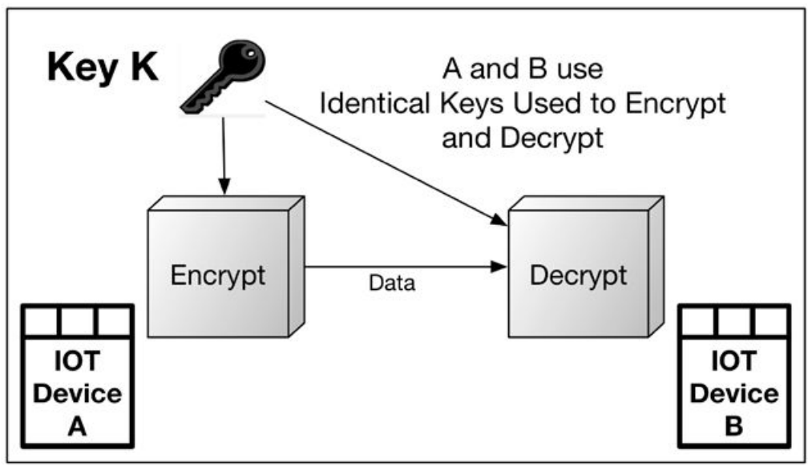
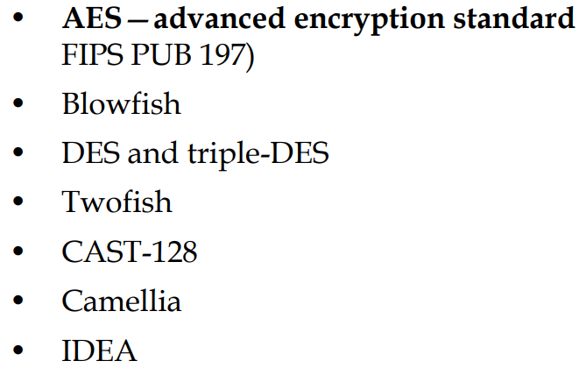
Symmetric encryption
Symmetric encryption simply means the sender (encryptor) and the receiver (decryptor) use an identical cryptographic key

Slide 7
Symmetric encryption: Block chaining modes
IV (initialization vector): is frequently needed to support certain cipher modes
Block chaining modes
https://en.wikipedia.org/wiki/Block_cipher_mode_of_operation
Electronic code book (ECB): No IV is necessary in ECB mode
cipher block chaining (CBC) mode, the encryption is bootstrapped by inputting an IV that is XOR'd with the first block of plaintext
Cipher-feedback chaining (CFB) and output feedback modes (OFB), each a variation on where the IV is initially used, what plaintext and ciphertext blocks are XOR'd, and so on
Counter modes
counter mode (CTR) and Galois counter mode (GCM).
In these, the plaintext data is not actually encrypted with the cipher and key, not directly anyway

Slide 8
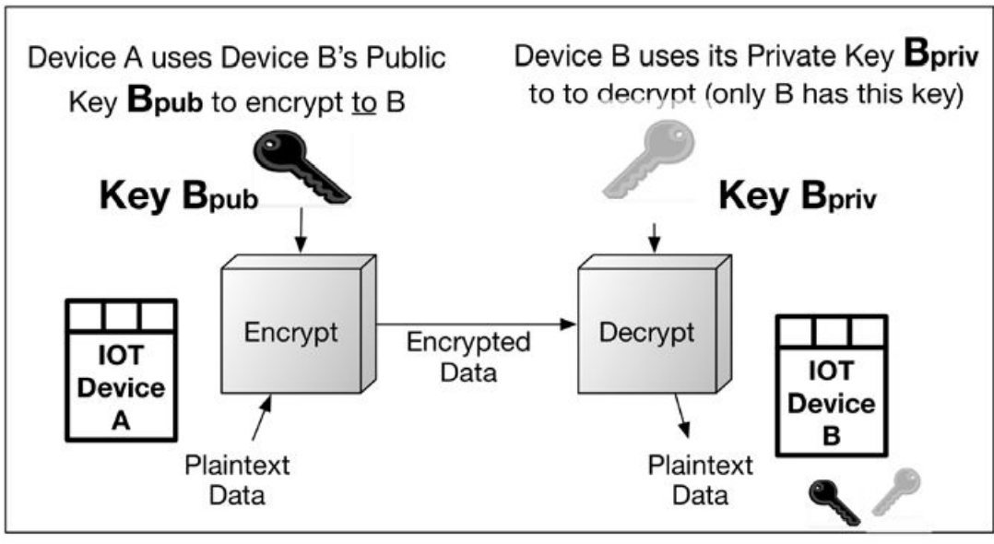
Asymmetric encryption
Asymmetric encryption simply means there are two different, pairwise keys, one public and the other private, used to encrypt and decrypt

Slide 9
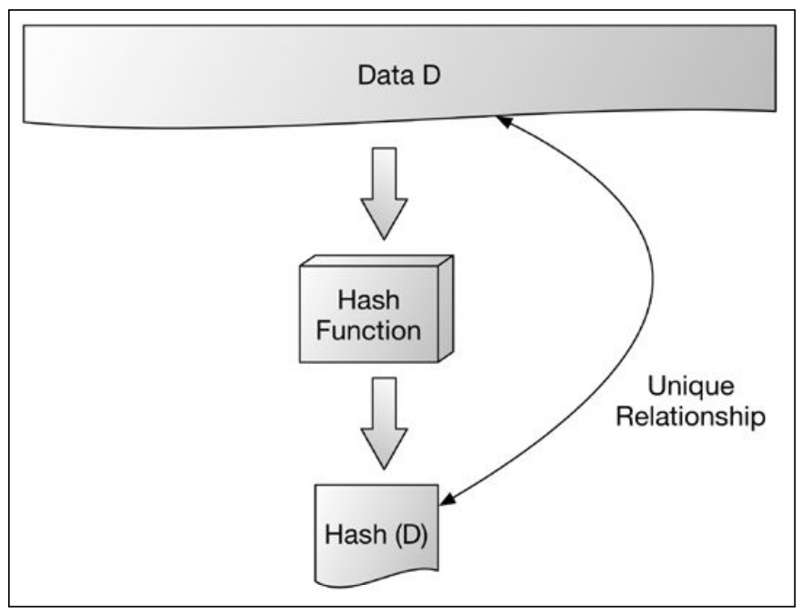
Hashes
Cryptographic hashes are used in a variety of security functions for their ability to represent an arbitrarily large message with a small sized, unique thumbprint (the hash)

Slide 10
Hashes
Hash functions are frequently used for the following purposes:
Protecting passwords and other authenticators by hashing them (the original password is then not revealed unless by a dictionary attack) into a random looking digest
Checking the integrity of a large data set or file by storing the proper hash of the data and re-computing that hash at a later time (often by another party). Any modification of the data or its hash is detectable.
Performing asymmetric digital signatures
Providing the foundation for certain message authentication codes
Performing key derivation
Generating pseudo-random numbers

Slide 11
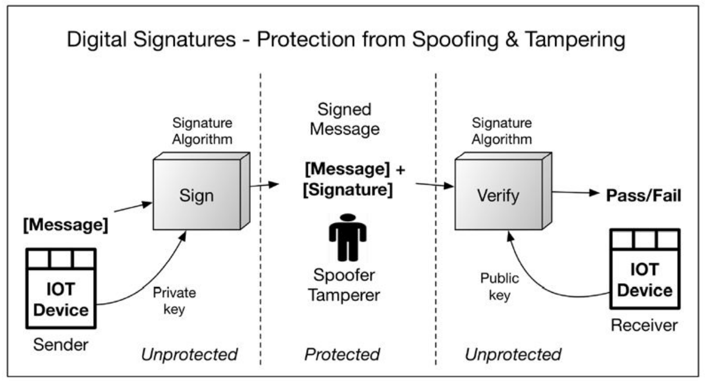
Digital signatures
A digital signature is a cryptographic function that provides integrity, authentication, data origin, and in some cases, non-repudiation protections.
Just like a hand-written signature, they are designed to be unique to the signer, the individual or device responsible for signing the message and who possesses the signing key.

Slide 12
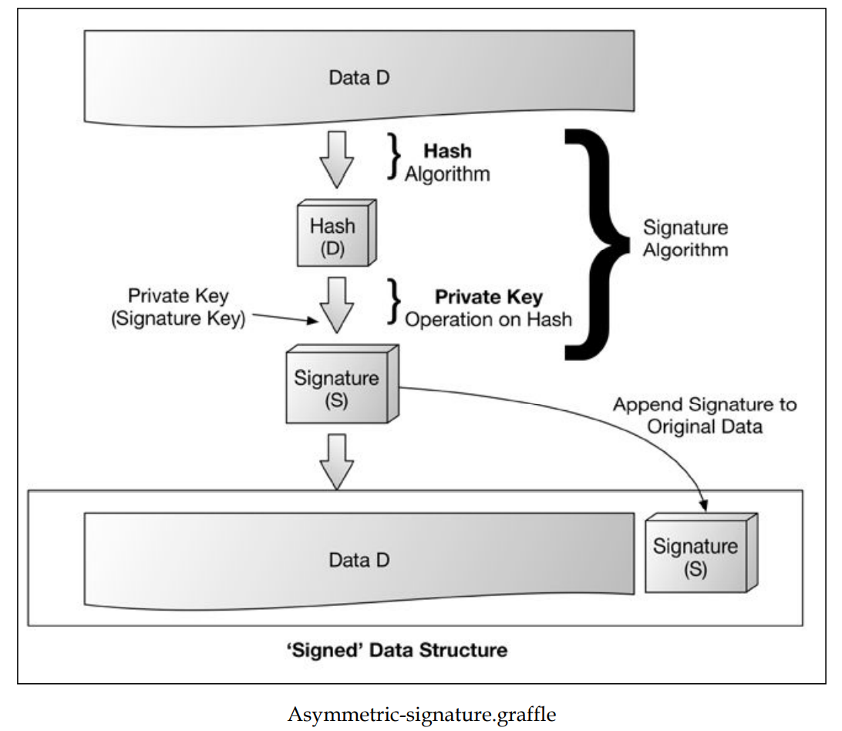
Digital signatures

Slide 13
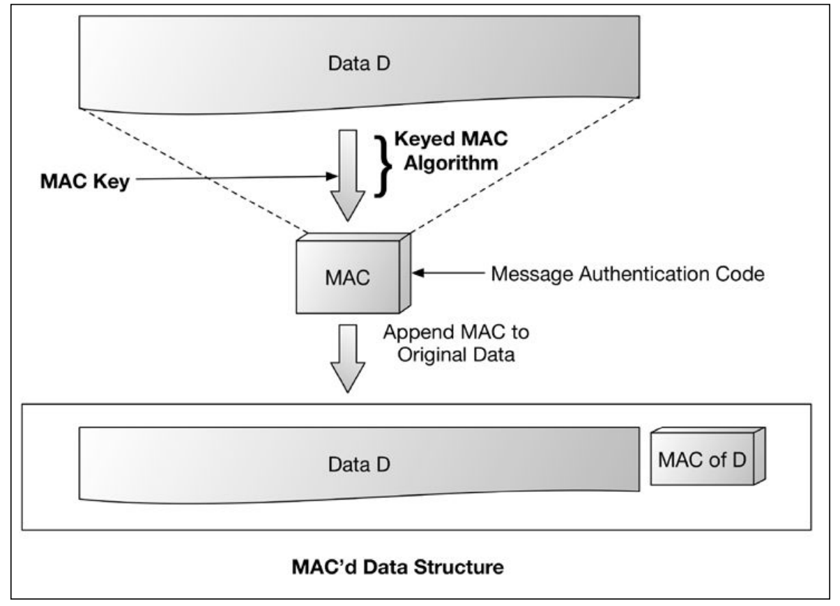
Symmetric (MACs)
Signatures can also be generated using symmetric cryptography. Symmetric signatures are also called MAC. MACs are used in a variety of protocols, such as SSL, TLS, IPSec, and many others.
• HMAC-SHA1
• HMAC-SHA256
• CMAC (using a block
cipher like AES)
• GMAC (GCM mode)

Slide 14
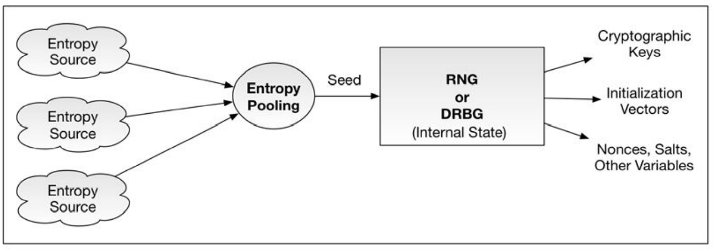
Random number generation
RNGs (the newer generation are called deterministic random bit generators, or DRBGs) are designed to produce random data for use as cryptographic keys, initialization vectors, nonces, padding, and other purposes

Slide 15
Ciphersuites
In many communication protocols, these algorithm groupings are often called cipher-suites
An example TLS cipher-suite enumeration: TLS_RSA_WITH_AES_128_GCM_SHA256, which interprets to using:
RSA algorithm for the server's public key certificate authentication (digital signature). RSA is also the public key-based key transport (for passing the client-generated pre-master secret to the server).
AES algorithm (using 128-bit length keys) for encrypting all data through the TLS tunnel.
AES encryption is to be performed using the Galois counter mode (GCM); this provides the tunnel's ciphertext as well as the MACs for each TLS datagram.
SHA256 to be used as the hashing algorithm.

Slide 16
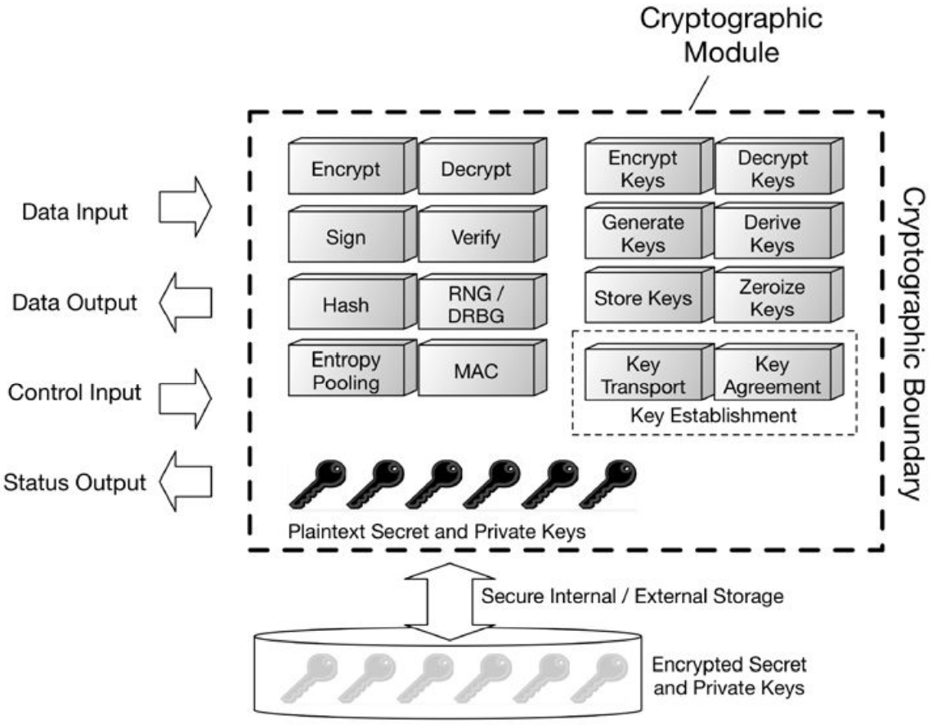
Cryptographic module principles
The cryptographic boundary, in FIPS 140-2, is an explicitly defined continuous perimeter that establishes the physical bounds of a cryptographic module and contains all the hardware, software, and/or firmware components of a cryptographic module.

Slide 17
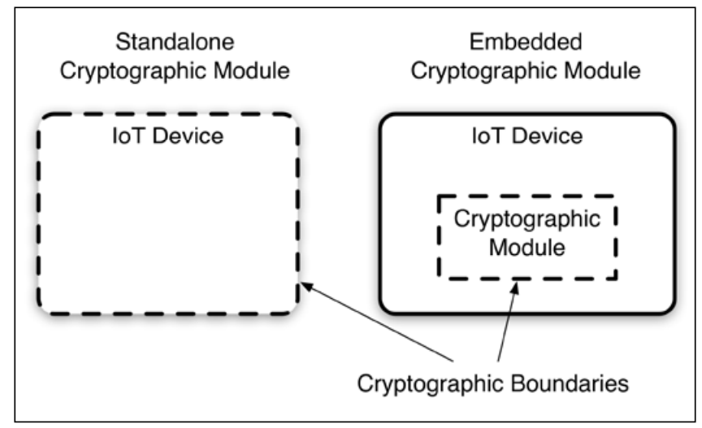
Cryptographic module principles

Slide 18
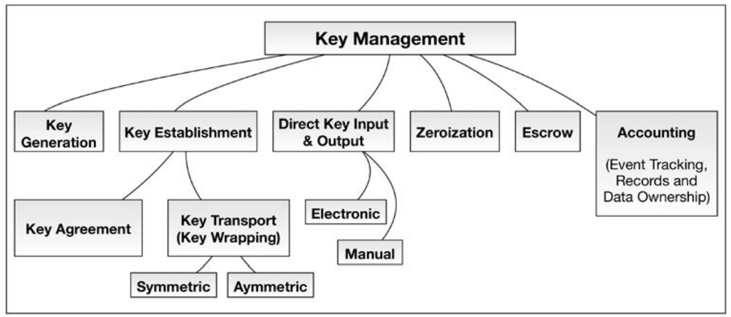
Cryptographic key management fundamentals

Slide 19
Key generation & Key establishment
Key generation
Keys should be generated using a well vetted RNG or DRBG seeded with sufficient min-entropy
Key establishment
Key agreement is the act of two parties contributing algorithmically to the creation of a shared key
Key transport is the act of one party transmitting a cryptographic key or its precursor to another party by first encrypting it with a key encryption key (KEK)

Slide 20
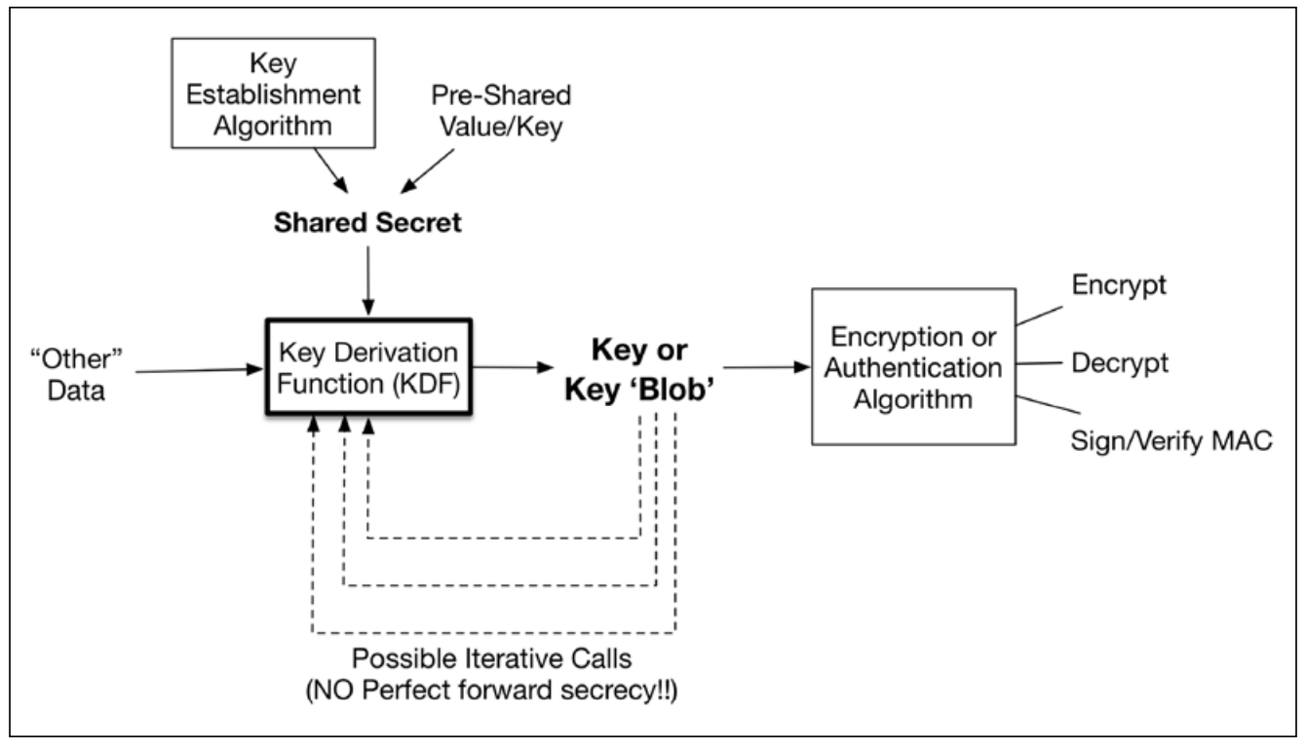
Key derivation
Key derivation refers to how a device or piece of software constructs cryptographic keys from other keys and variables, including passwords (so called password-based key derivation)

Slide 21
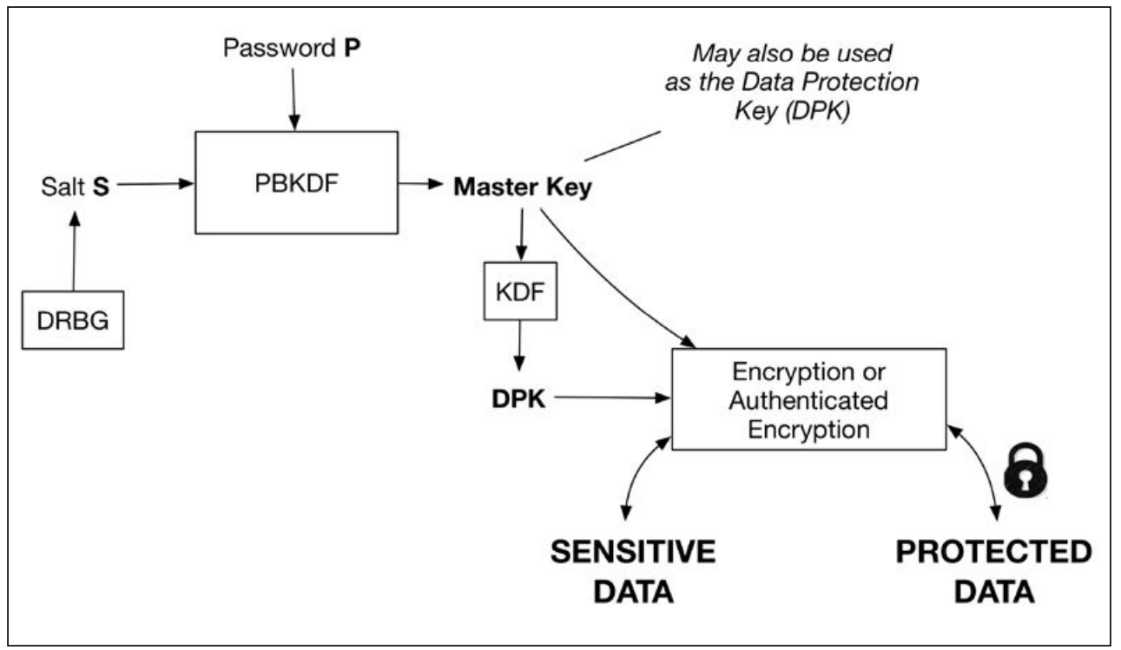
Key derivation
Password-based key derivation (PBKDF) is the process of deriving, in part, a cryptographic key from a unique password and is specified in NIST SP 800-132.

Slide 22
Key storage
Key storage
Key storage refers to how secure storage of keys
hardware security module (HSM)
Key escrow
Key lifetime
Key zeroization
Accounting and management

Slide 23
Examining cryptographic controls for IoT protocols
IoT point-to-point and end-to-end communications would be impossible to secure
Cryptographic controls built into IoT communication protocols
Cryptographic controls built into IoT messaging protocols

Slide 24
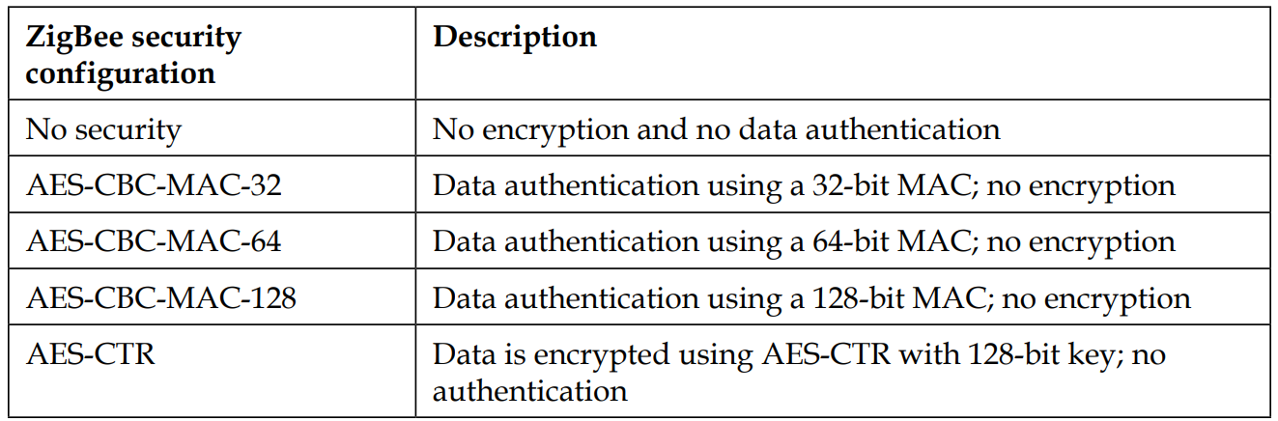
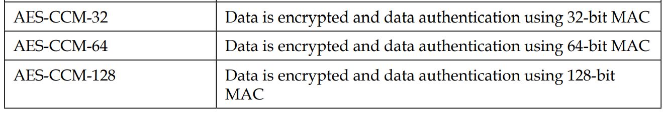
ZigBee

Slide 25
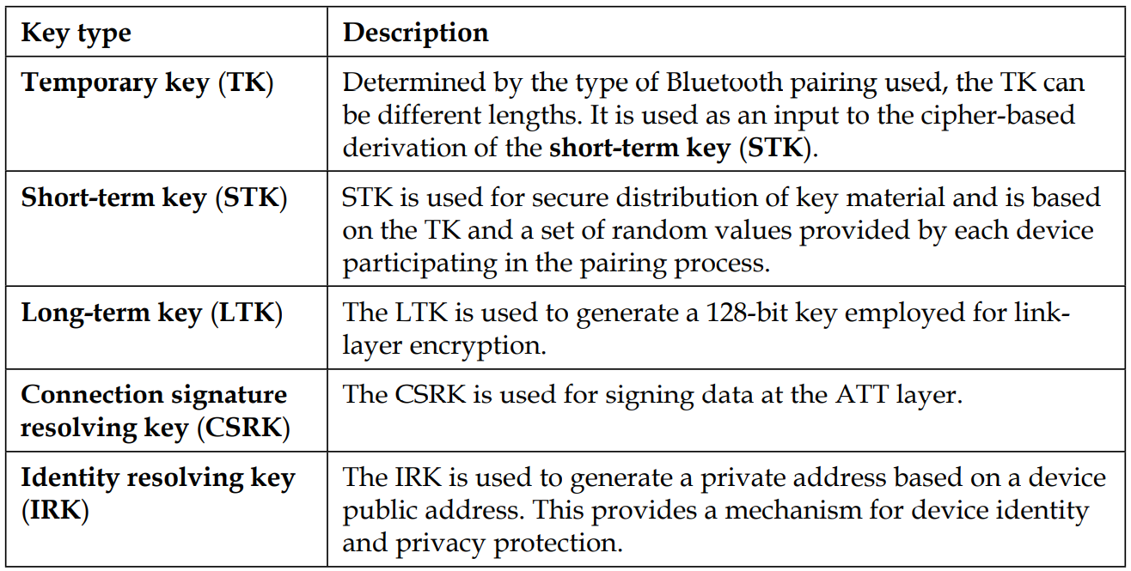
Bluetooth-LE

Slide 26
Cryptographic controls built into IoT messaging protocols
MQTT
CoAP
DDS
REST

Slide 27
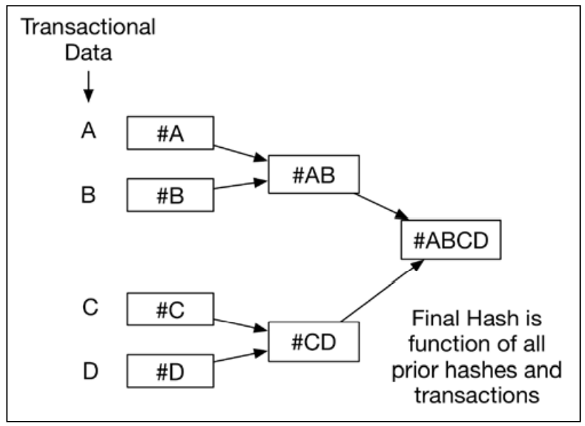
Future directions of the IoT and cryptography

Slide 28
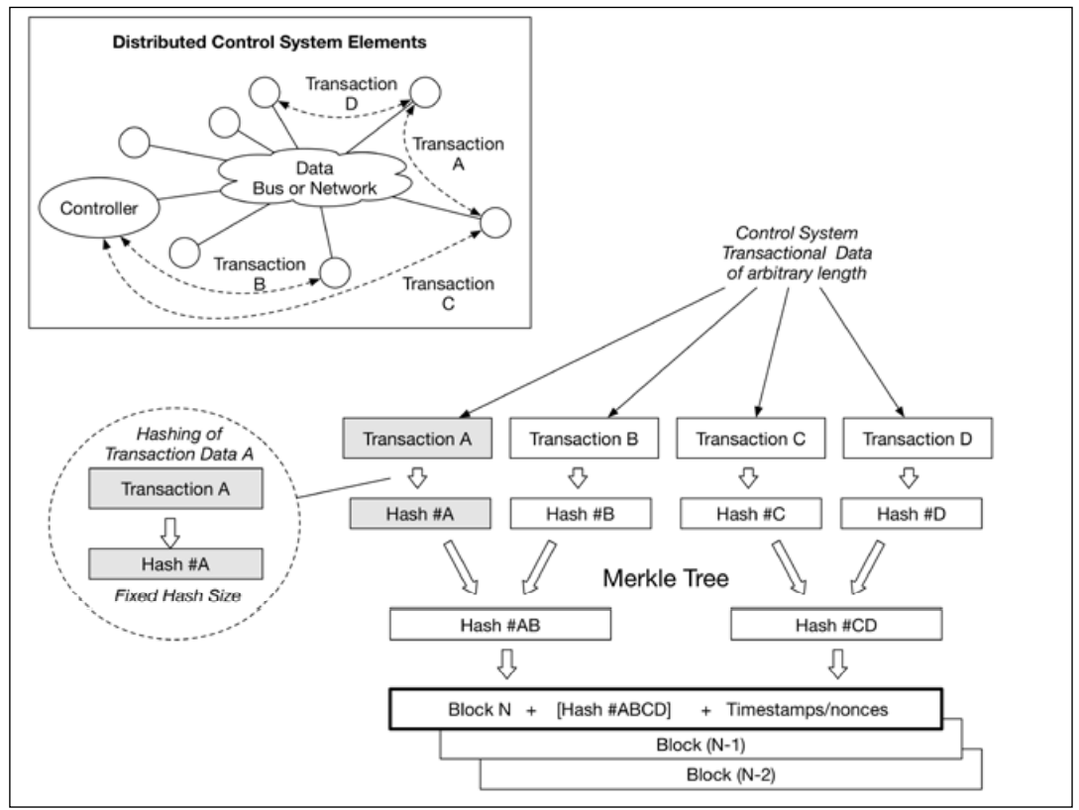
Future directions of the IoT and cryptography

Slide 29
Q&A

